Slide 1
Translational Imaging in Drug Safety Assessment
Background to the IMI-2 Project “TRISTAN”
2nd March 2017

Slide 2
Drug safety assessment
Before new drugs are marketed, regulatory authorities must be satisfied that the benefits from the new drug outweigh any harms that might occur.
The characterisation and amelioration of potential harms is called Drug Safety Assessment.

Slide 3
HARM
BENEFIT

Slide 4
The drug safety challenge
Harrison RK. Phase II & phase III failures: 2013–2015
Nature Reviews Drug Discovery 15, 817–818 (2016) http://dx.doi.org/10.1038/nrd.2016.184
During development
25% of failures Ph2 2013-15 due to safety
14% of failures Ph3 2013-15 due to safety
Post launch
6.7% of hospitalised patients in USA had serious adverse drug reactions (1994)
462 drugs withdrawn for safety post-marketing (world literature)
Lazarou J et al. Incidence of Adverse Drug Reactions in Hospitalized Patients. A Meta-analysis of Prospective Studies.JAMA 279:1200-1205 (1998). http://dx.doi.org/10.1001/jama.279.15.1200
Onakpoya IJ et al. Post-marketing withdrawal of 462 medicinal products because of adverse drug reactions: a systematic review of the world literature BMC Medicine 14:10 (2016) http://dx.doi.org/10.1186/s12916-016-0553-2
Siramshetty VB et al. WITHDRAWN: a resource for withdrawn and discontinued drugs. Nucleic Acids Res (2016) 44 (D1): D1080-D1086. https://doi.org/10.1093/nar/gkv1192
http://cheminfo.charite.de/withdrawn/toxicities.html

Slide 5
Failures harm people, Failures threaten drug research itself
Some high-profile developments stopped because of harm
TGN1412
BIA 10-2474
Fialuridine
Some high-profile withdrawals post-launch
encainide
ximelagatran
cerivastatin
rofecoxib
practolol
tolrestat
rosiglitazone
thalidomide
fenfluramine/phentermine
epanolol

Slide 6
Using safety biomarkers to stop drugs
Marketing
Phase 4
Phase1
Phase 2
Phase 3
NDA/MAA
CD toxicology
Stop development
NDA/ MAA refused
Withdrawal
Don’t develop

Slide 7
Alle Ding' sind Gift, und nichts ohn' Gift; allein die Dosis macht, daß ein Ding kein Gift ist
Phillippus Aureolus Theophrastus Bombastus von Hohenheim
“Paracelsus”
1493 -1541

Slide 8
Using safety biomarkers to proceed with caution
Marketing
Phase 4
Phase1
Phase 2
Phase 3
NDA/MAA
CD toxicology
therapeutic margin, reversibility
mechanism
study design
NDA/ MAA labelling
labelling
Contraindications
Inclusion criteria
Personalised healthcare
Monitoring

Slide 9
Biomarkers
“A defined characteristic that is measured as an indicator of
normal biological processes,
pathogenic processes, or
responses to an exposure or intervention, including therapeutic interventions.
“Molecular, histologic, radiographic, or physiologic characteristics are types of biomarkers.”
“A biomarker is not an assessment of how an individual feels, functions, or survives”
Categories of biomarker:
susceptibility/risk,
diagnostic,
monitoring,
prognostic,
predictive,
pharmacodynamic/response,
safety
https://www.ncbi.nlm.nih.gov/books/NBK338448

Slide 10
Why use imaging biomarkers?
Non-invasive follow-up and reversibility
Well-suited to sites of unmet need e.g. liver, kidney, heart, lung, brain
Measures focal damage
Routinely used by Pharma to avoid ADRs in trials
core lab support
Routinely used in healthcare to avoid ADRs
Regulatory acceptance of imaging biomarkers:
Imaging biomarkers successful in FDA biomarker qualification process
Imaging biomarkers used by FDA as surrogate endpoints 30 times 2010-14
Imaging biomarkers approved by FDA as companion diagnostics
Distinct but feasible validation roadmap
Collaborative non-proprietary route

Slide 11
Established imaging biomarkers for safety assessment
Imaging biomarkers are routinely used:
for early stop in development
to set therapeutic margin
to compare investigational drugs
to show reversibility
in regulatory labelling – contraindications
in regulatory labelling – recommended monitoring
also in animals

Slide 12
Established imaging biomarkers for safety assessment
Some routinely used safety imaging biomarkers:
Left ventricular ejection fraction biomarker of cardiotoxicity (Ultrasound, MRI, SPECT)
Amyloid-related MR imaging abnormalities with edema/effusions (ARIA-E), microhaemorrhage (ARIA-H)
Abnormal biodistribution (SPECT, PET)
Bone Mineral Density (DXA)

Slide 13
Validation challenges
Imaging biomarker: Scanner in hospital | Biospecimen biomarker: In vitro diagnostic device in biomarker lab
Different scanners from different vendors installed in different hospitals | Identical IVDDs
Scanners not designed, maintained or approved for measuring biomarkers | IVDDs designed, maintained and approved for specific measurement
Staff whose main job role is not quantitation | Trained, dedicated staff
Quality depends mainly on events at the moment of scanning | Quality depends mainly on the central lab
Picture quality drives innovation: unpredictable effect on quantitation | Stable platform due to regulatory approval
Seldom defined analytes | Defined molecular entity via analytical biochemistry

Slide 14
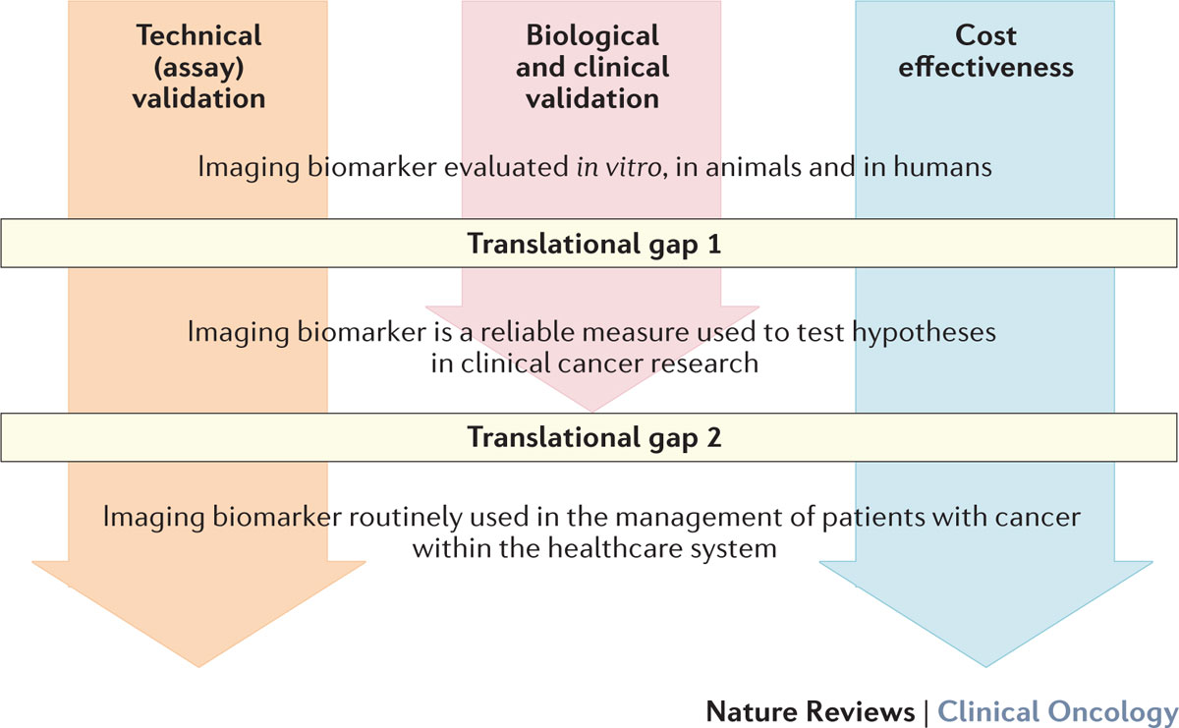
Distinct imaging biomarker roadmap:
validation activities in parallel, not in series
Imaging biomarker roadmap for cancer studies James P. B. O'Connor, Eric O. Aboagye, Judith E. Adams, Hugo J. W. L. Aerts, Sally F. Barrington, Ambros J. Beer, Ronald Boellaard, Sarah E. Bohndiek, Michael Brady, Gina Brown, David L. Buckley, Thomas L. Chenevert, Laurence P. Clarke, Sandra Collette, Gary J. Cook, Nandita M. deSouza, John C. Dickson, Caroline Dive, Jeffrey L. Evelhoch, Corinne Faivre-Finn, Ferdia A. Gallagher, Fiona J. Gilbert, Robert J. Gillies, Vicky Goh, John R. Griffiths, Ashley M. Groves, Steve Halligan, Adrian L. Harris, David J. Hawkes, Otto S. Hoekstra, Erich P. Huang, Brian F. Hutton, Edward F. Jackson, Gordon C. Jayson, Andrew Jones, Dow-Mu Koh, Denis Lacombe, Philippe Lambin, Nathalie Lassau, Martin O. Leach, Ting-Yim Lee, Edward L. Leen, Jason S. Lewis, Yan Liu, Mark F. Lythgoe, Prakash Manoharan, Ross J. Maxwell, Kenneth A. Miles, Bruno Morgan, Steve Morris, Tony Ng, Anwar R. Padhani, Geoff J. M. Parker, Mike Partridge, Arvind P. Pathak, Andrew C. Peet, Shonit Punwani, Andrew R. Reynolds, Simon P. Robinson, Lalitha K. Shankar, Ricky A. Sharma, Dmitry Soloviev, Sigrid Stroobants, Daniel C. Sullivan, Stuart A. Taylor, Paul S. Tofts, Gillian M. Tozer, Marcel van Herk, Simon Walker-Samuel, James Wason, Kaye J. Williams, Paul Workman, Thomas E. Yankeelov, Kevin M. Brindle, Lisa M. McShane, Alan Jackson, John C. Waterton Nature Reviews Clinical Oncology (2017) http://dx.doi.org/10.1038/nrclinonc.2016.162
Notes:
Figure 1 | Overview of the imaging biomarker roadmap. Imaging biomarkers must cross translational gap 1 to become robust medical research tools, and translational gap 2 to be integrated into routine patient care. This goal is achieved through three parallel tracks of technical (assay) validation, biological and clinical validation, and cost effectiveness.

Slide 15
Key validation activities
Imaging-pathology correlation and reversibility
Animal studies also important here
Standardisation
Non-proprietary or non-exclusive
Consider public-private partnership e.g. IMI
Agnostic to particular imaging device
FDA qualification programme, not IVD or 510(k)
Standardisation by expert groups
radiologist/imager; multiple pharma precompetitive regulator; disease physician; academic societies
Regular revision as new devices are marketed
Repeatability and reproducibility
Availability
Preclinical: near-GLP implementations available in valid animal model
Trials: Imaging biomarker is implemented validly to ICH GCP (use core lab) in every hospital in the world where the trial recruits
Post-marketing: Imaging biomarker is: available, robustly valid, inexpensive in every hospital in the world where the drug is prescribed

